Slide 1
Black & White Photography & Monochrome

Slide 2
B/W Photo
Adjective: displaying only black and white tones and shades of gray; without color
The neutral tones of black, white, and intermediate shades of gray

Slide 3
1

Slide 4
2

Slide 5
3

Slide 6
4

Slide 7
5

Slide 8
6

Slide 9
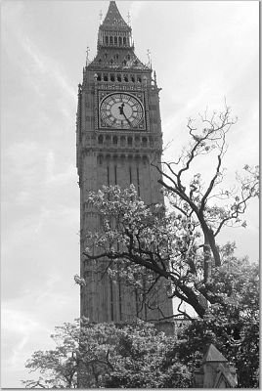
7

Slide 10
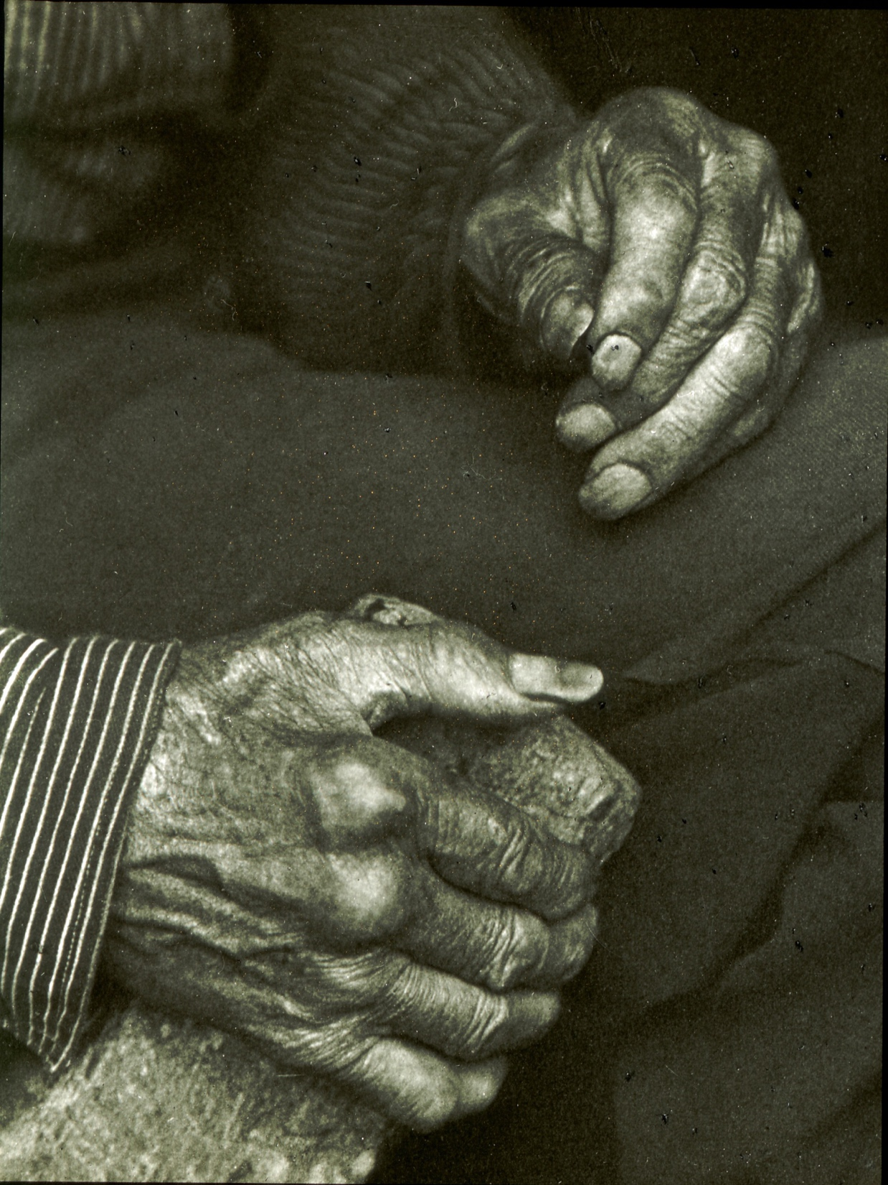
8

Slide 11
Cool

Slide 12
Cool

Slide 13
Warm

Slide 14
Warm

Slide 15
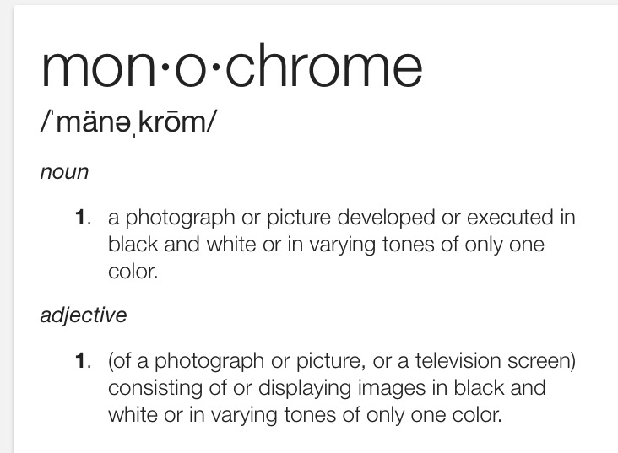
9

Slide 16
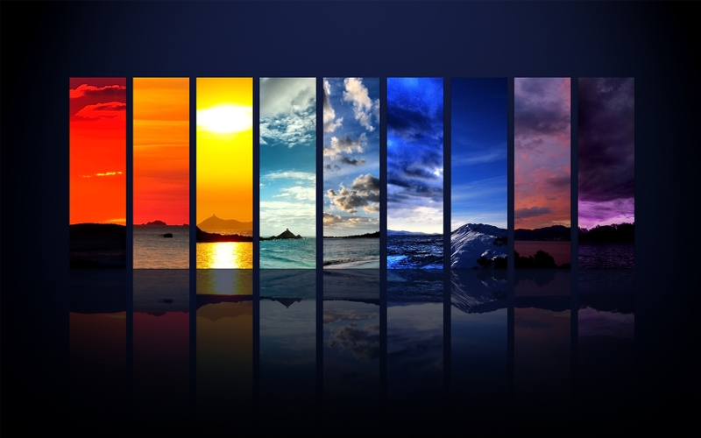
10

Slide 17
Yellow

Slide 18
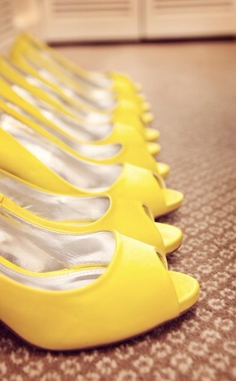
11

Slide 19
12

Slide 20
13

Slide 21
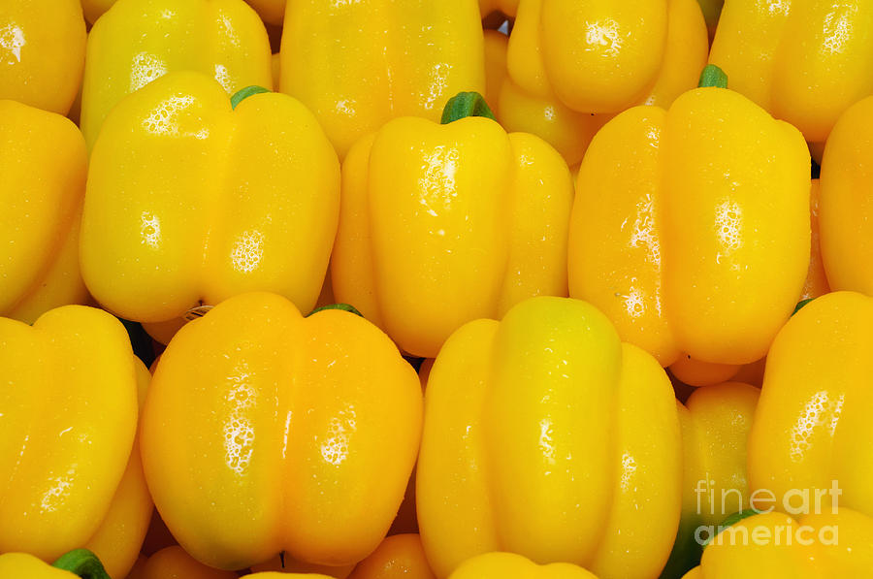
14

Slide 22
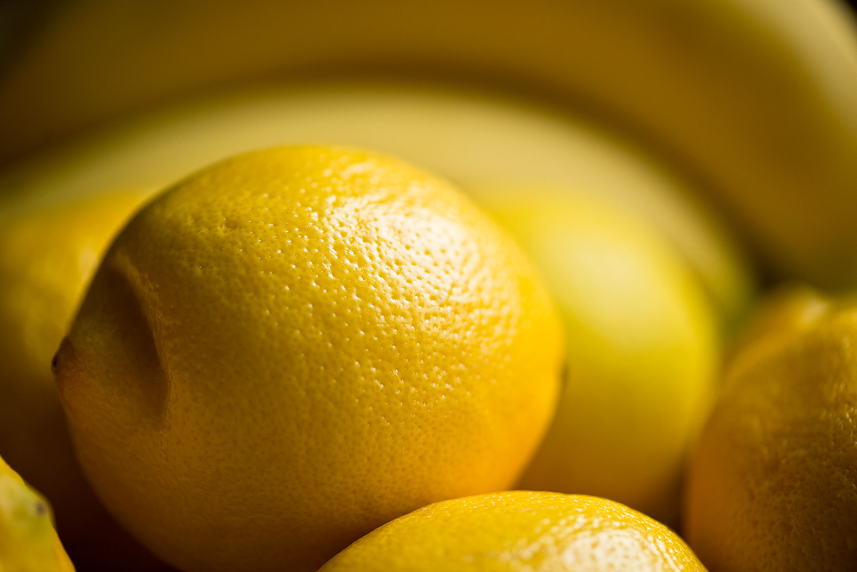
15

Slide 23
16

Slide 24
17

Slide 25
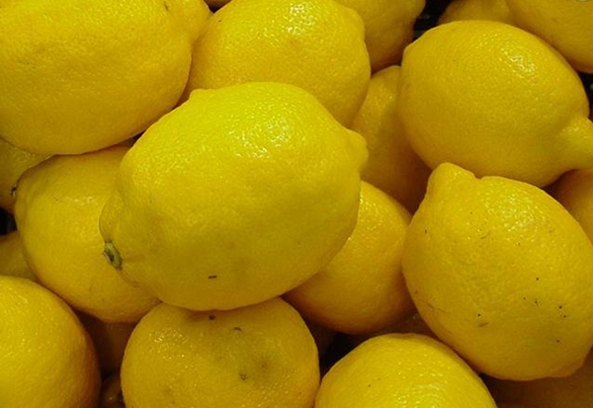
18

Slide 26
19

Slide 27
Orange

Slide 28
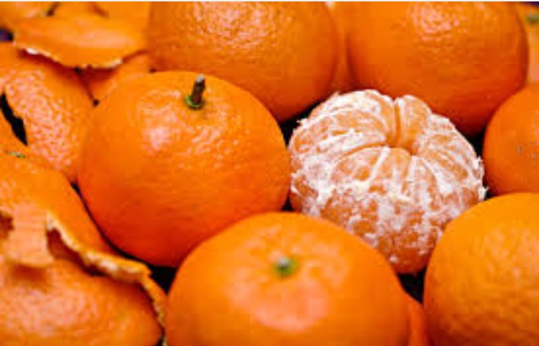
20

Slide 29
21

Slide 30
22

Slide 31
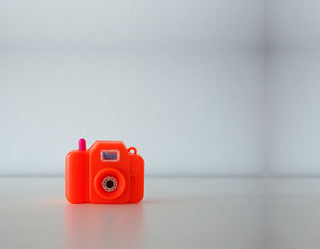
23

Slide 32
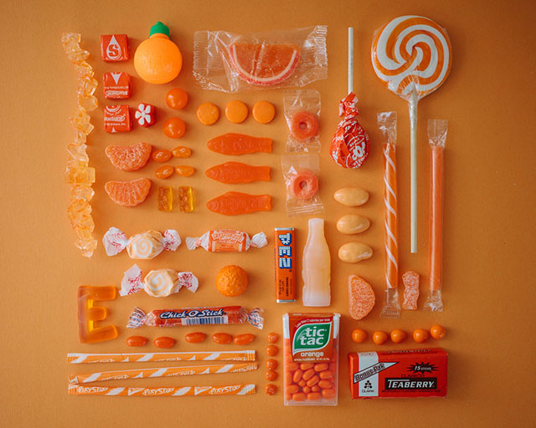
24

Slide 33
25

Slide 34
Red

Slide 35
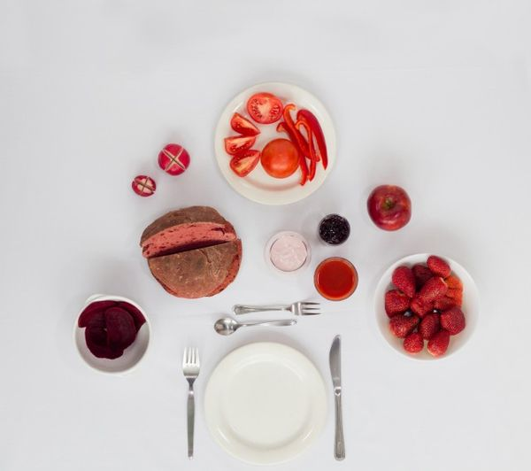
26

Slide 36
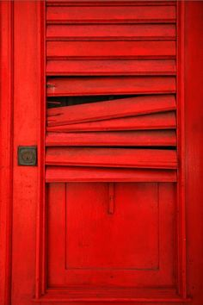
27

Slide 37
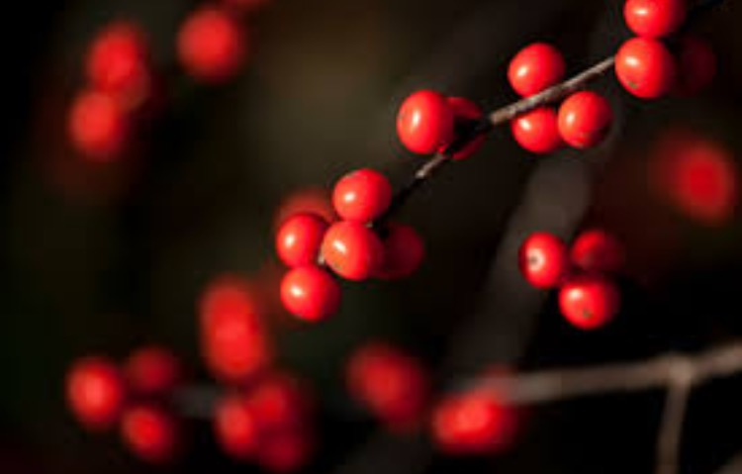
28

Slide 38
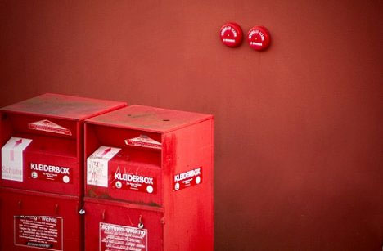
29

Slide 39
30

Slide 40
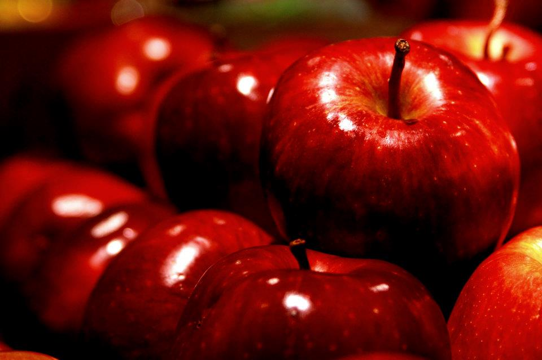
31

Slide 41
32

Slide 42
33

Slide 43
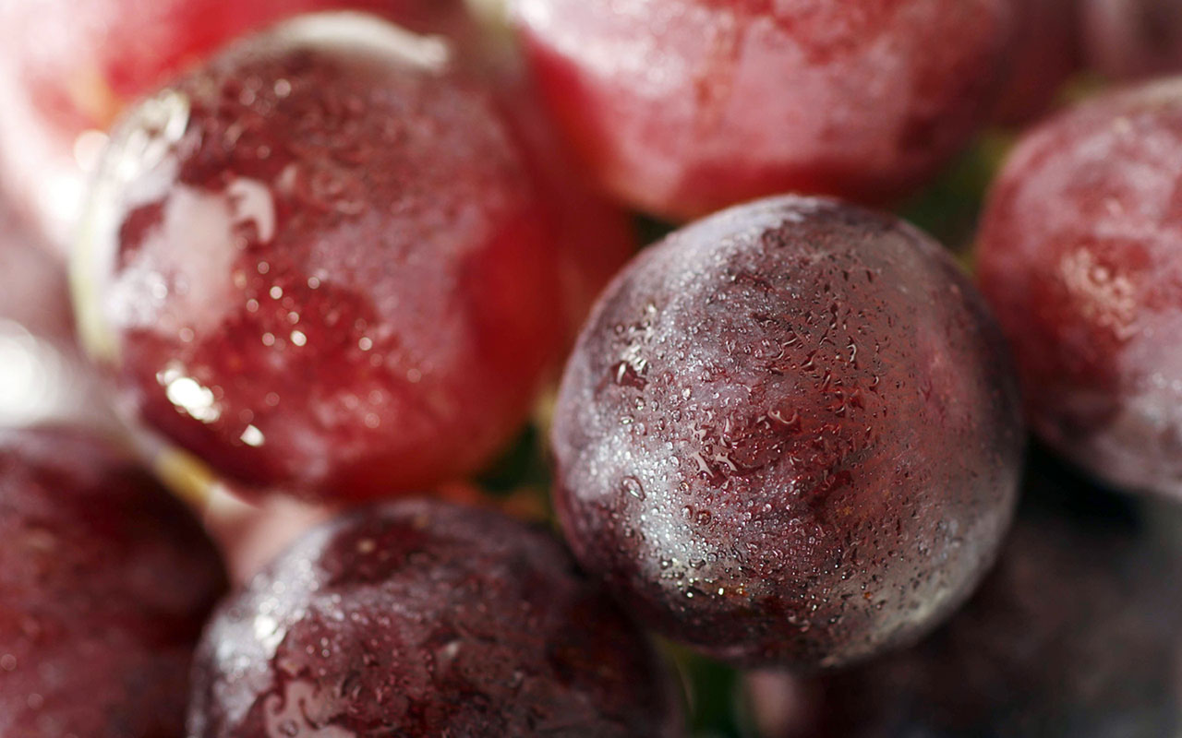
34

Slide 44
35

Slide 45
36

Slide 46
Violet

Slide 47
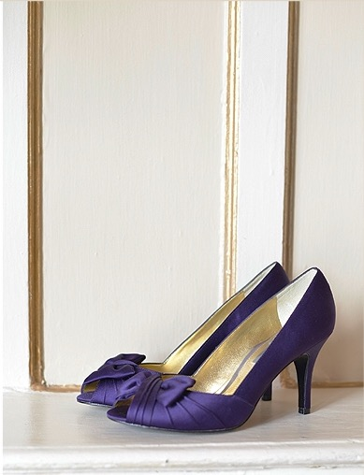
37

Slide 48
38

Slide 49
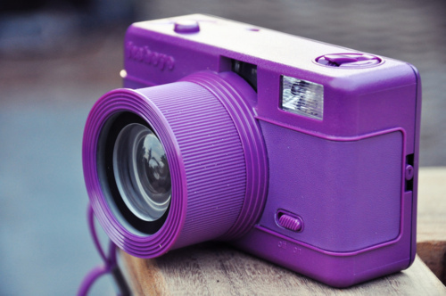
39

Slide 50
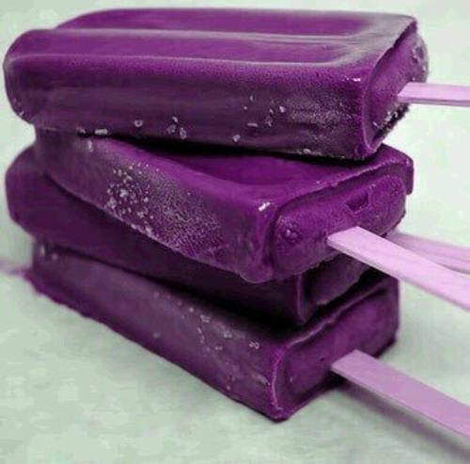
40

Slide 51
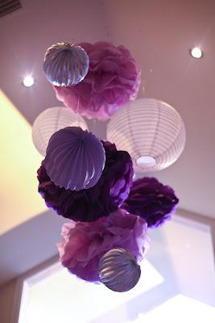
41

Slide 52
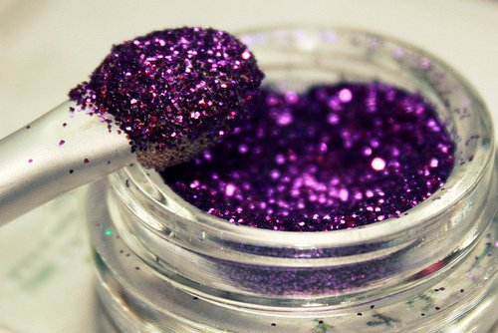
42

Slide 53
43

Slide 54
44

Slide 55
Blue

Slide 56
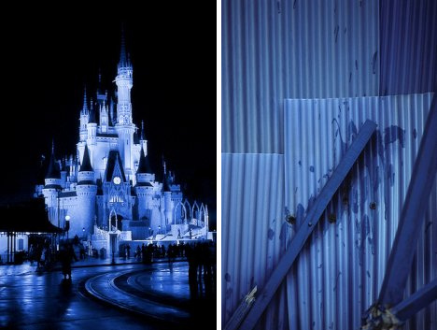
45

Slide 57
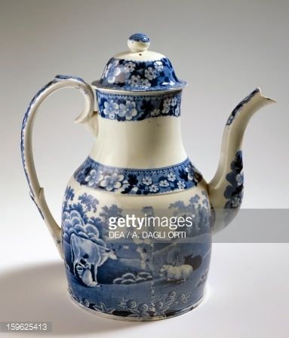
46

Slide 58
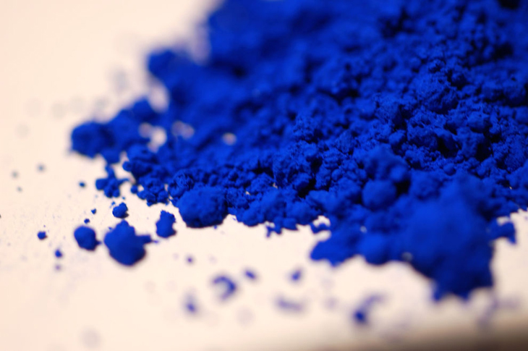
47

Slide 59
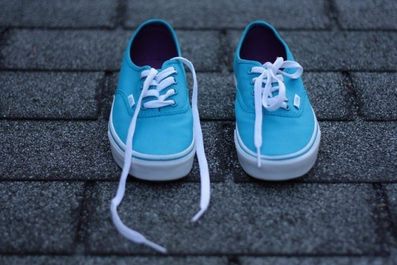
48

Slide 60
49

Slide 61
50

Slide 62
51

Slide 63
52

Slide 64
Green

Slide 65
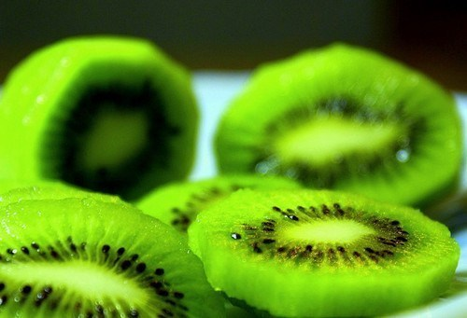
53

Slide 66
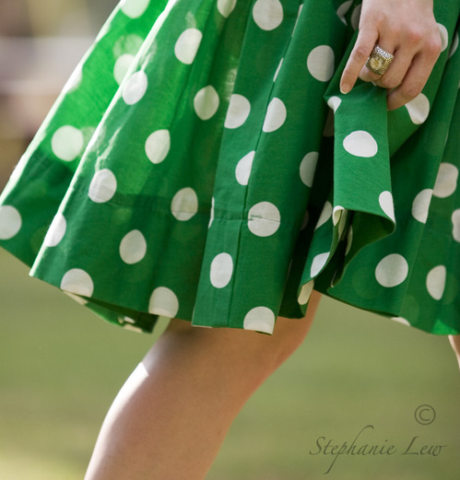
54

Slide 67
55

Slide 68
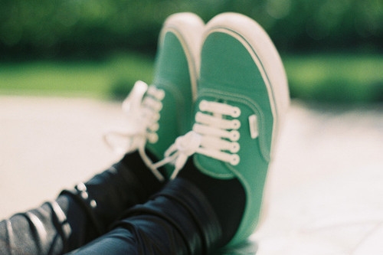
56

Slide 69
57

Slide 70
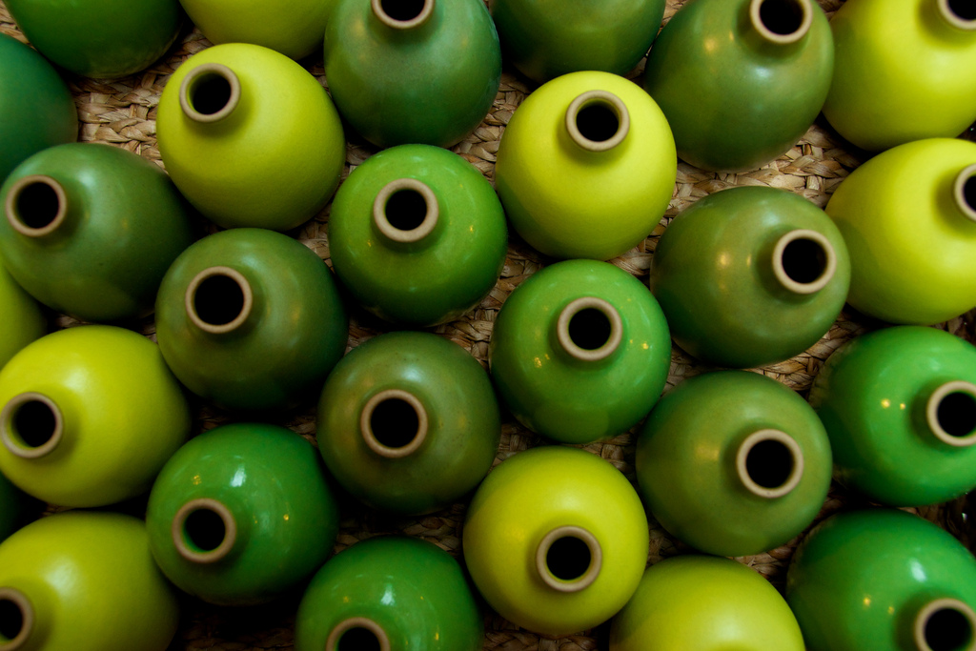
58

Slide 71
Brown

Slide 72
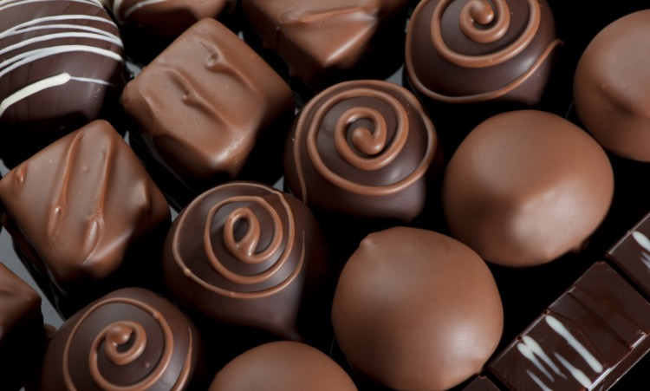
59

Slide 73
60

Slide 74
61

Slide 75
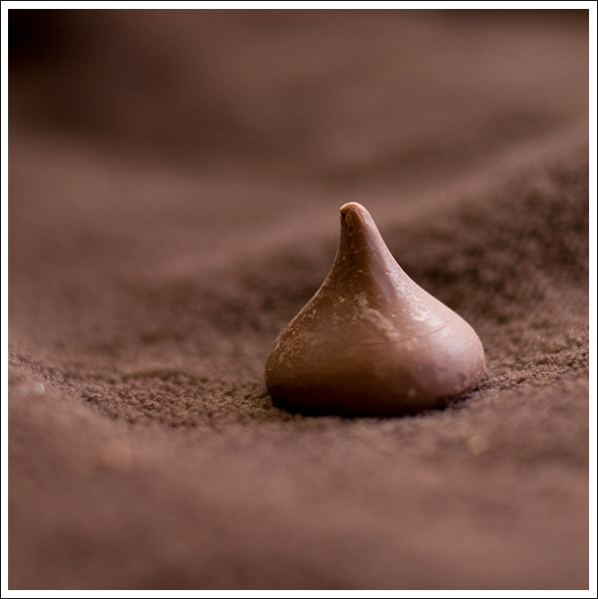
62

Slide 76
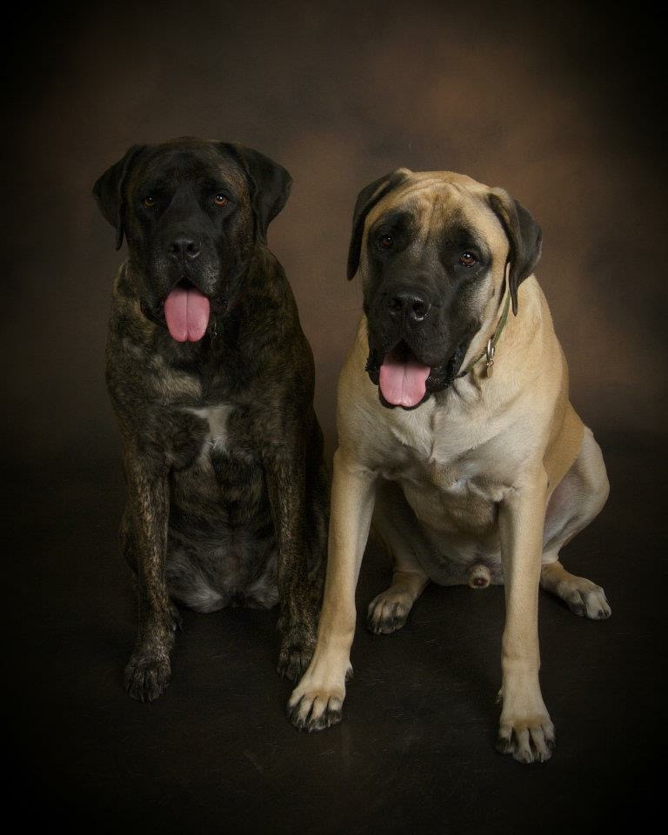
63

